Slide 1

ESP32-Based Temperature and Humidity Monitoring System For Hospital Medicines Store
NAME: Aogon Francis
Reg. No.: 24/U/0282/GIM/PS
EMBEDED SYSTEMS

Slide 2
Introduction
Medicines like insulin and vaccines are sensitive to environmental conditions.
Improper storage compromises efficacy and patient safety.
ESP32 offers a low-cost, real-time monitoring solution.

Slide 3
Challenges in Hospital Medicine Stores
No real-time monitoring of temperature and humidity.
Lack of automatic alerts on threshold breaches.
Manual logging is error-prone.
Non-compliance with regulations.
Spoilage of critical medicines.

Slide 4
Project Objective
Monitor temperature and humidity using ESP32 + DHT11.
Display readings on a web dashboard + serial monitor.
Make alarm when thresholds are exceeded.
Turn on the Air-conditioner when thresholds are exceeded

Slide 5
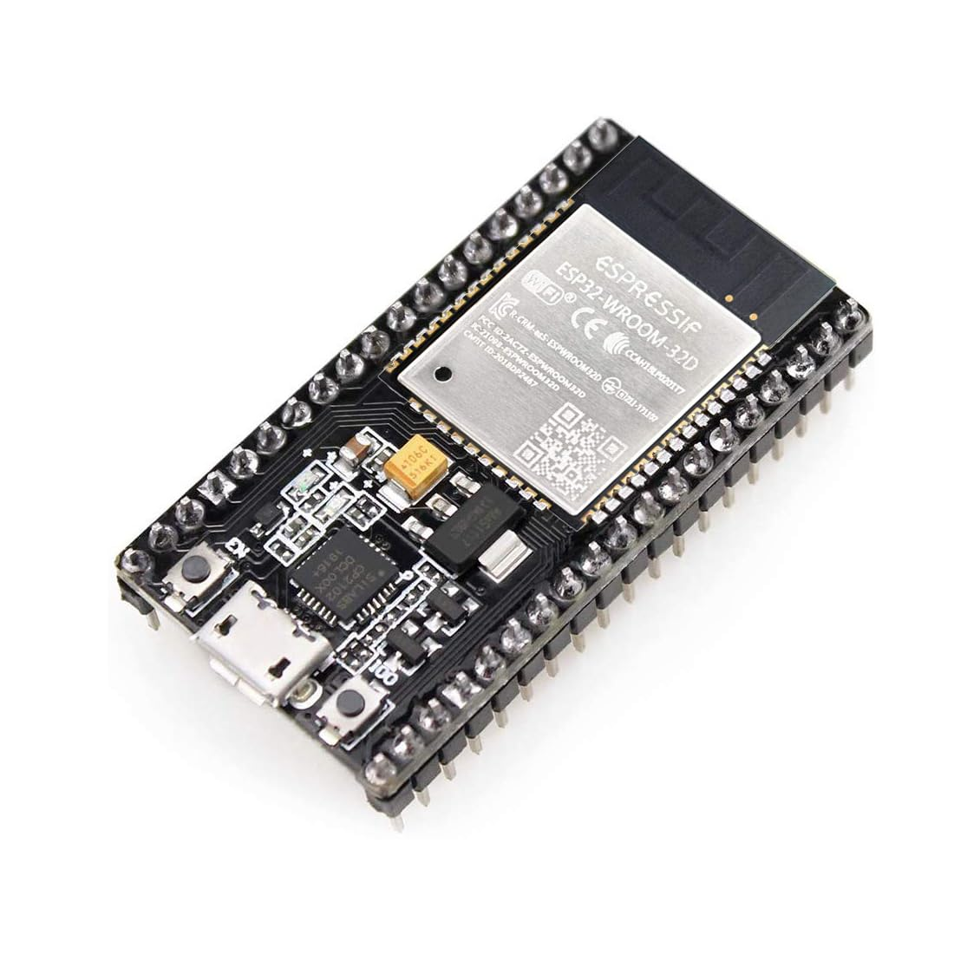
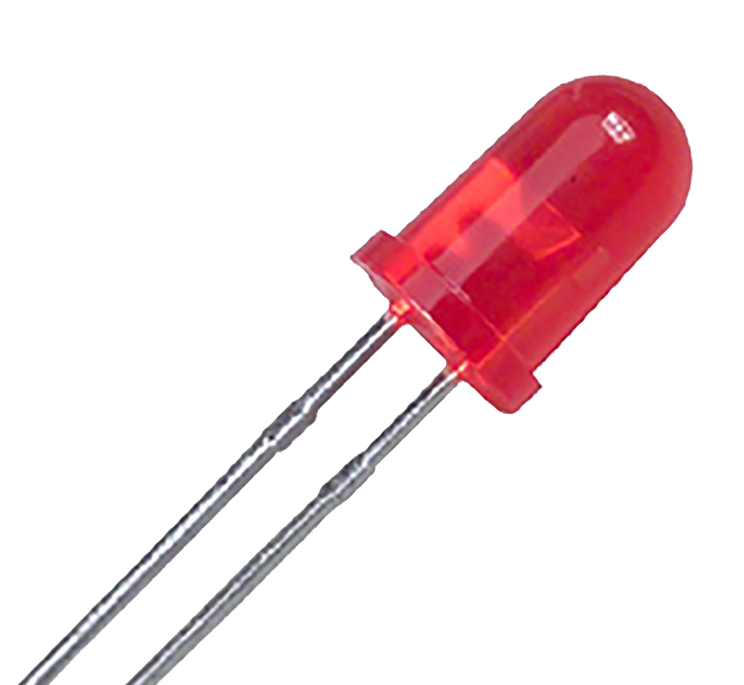
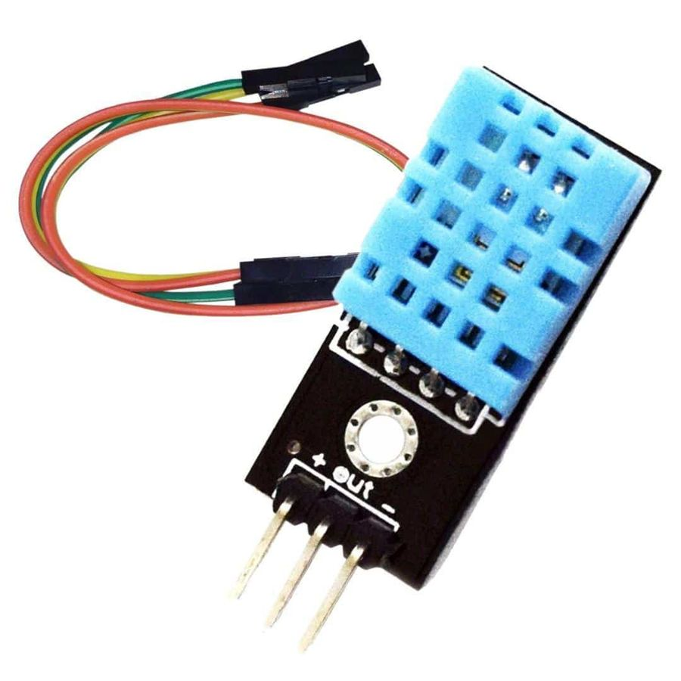
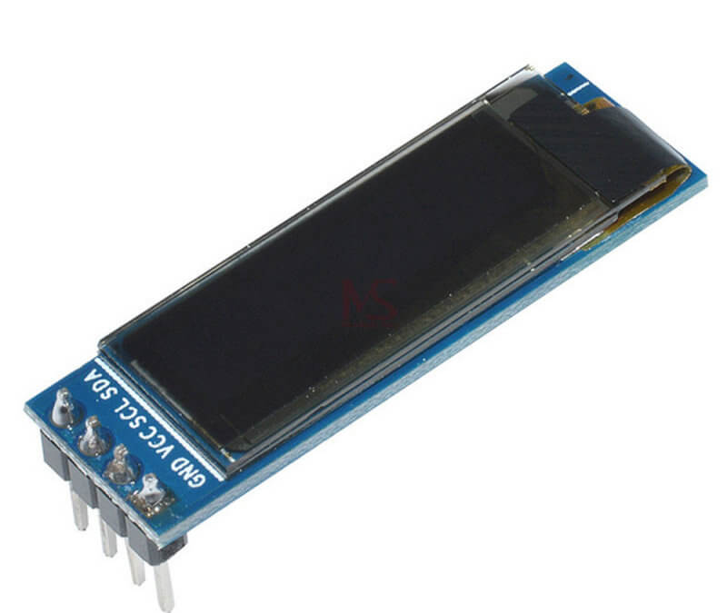


Core Components
ESP32 Microcontroller - central unit with Wi-Fi.
DHT22 Sensor - accurate temperature and humidity sensor.
OLED Display - optional for local monitoring.
Wi-Fi module - for transmitting data.
Power Supply - USB or battery (5 volts).
Buzzer
RED LED

Slide 6
Software Design
Firmware developed in Arduino IDE.
Libraries: DHT.h, WiFi.h, ESPAsyncWebServer.h.
Dashboard: HTML, CSS, JS.

Slide 7
System Workflow
ESP32 initializes and connects to Wi-Fi.
Reads DHT11 data every few seconds.
Displays on OLED and web dashboard.
Triggers alerts if thresholds exceeded.
Triggers alarm on Buzzer and Red LED

Slide 8
Optional Enhancements
Battery backup for power outages.
Multiple sensors using I2C or multiple ESP32s.
Integration with hospital database.
Remote access via cloud or port forwarding.
SMS / Email Alerts
Logging of Readings for future Audit

Slide 9
Impact and Benefits
Ensures drug safety and quality.
Supports regulatory compliance.
Real-time alerts prevent spoilage.
Reduces costs due to wasted medicine.
Scalable across departments or facilities.

Slide 10
Conclusion
ESP32 system addresses storage monitoring issues.
Provides accurate, timely alerts and logs.
Affordable, efficient, and scalable solution.
A vital tool for hospital medicine safety.

